Slide 1
Smart watch and Biopac: using GSR data for distinguishing cognitive states
Guido Zuidhof
December 2014

Slide 2
Cognitive load measurement
Many approaches to measuring cognitive load
R. Brünken et al. (2003), Direct Measurement of Cognitive Load in Multimedia Learning. Educational Psychologist 38(1), 53-61
 | Indirect | Direct
Subjective | Self-reported invested mental effort | Self-reported stress level Self-reported difficulty of materials
Objective | Physiological measures Behavioral measures Learning outcome measures | Dual-task performance Brain activity measures (e.g. fMRI) (arguably also indirect)

Slide 3
Cognitive load measurement
Many approaches to measuring cognitive load
 | Indirect | Direct
Subjective | Self-reported invested mental effort | Self-reported stress level Self-reported difficulty of materials
Objective | Physiological measures Behavioral measures Learning outcome measures | Dual-task performance Brain activity measures (e.g. fMRI) (arguably also indirect)

Slide 4
Physiological response
The body displays a response under an increased cognitive load
Many different options for measuring

Slide 5
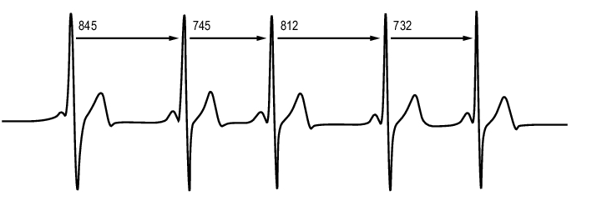
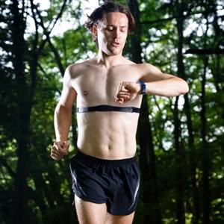
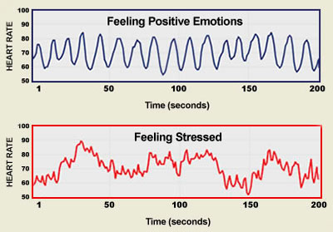
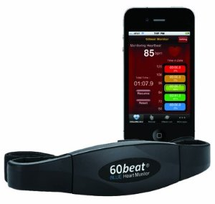
Heart rate variability (HRV)
Time between heart beats

Slide 6
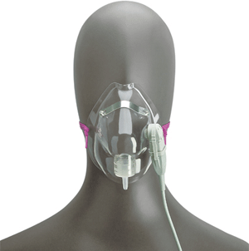
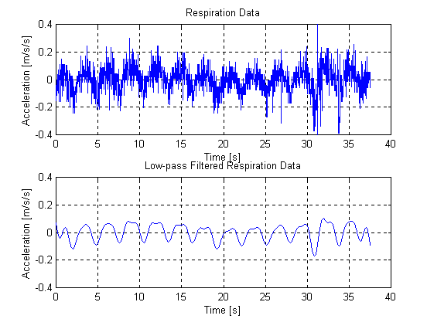
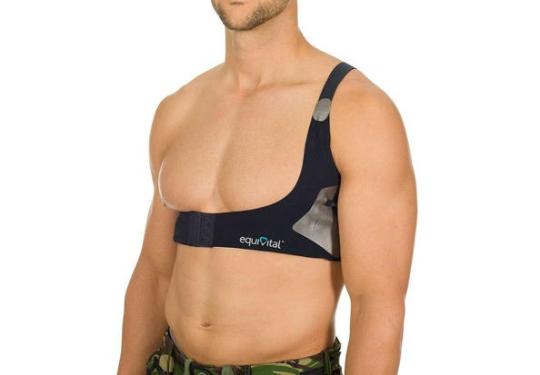
Respiratory rate
Or Ventilatory rate, Breathing frequency

Slide 7
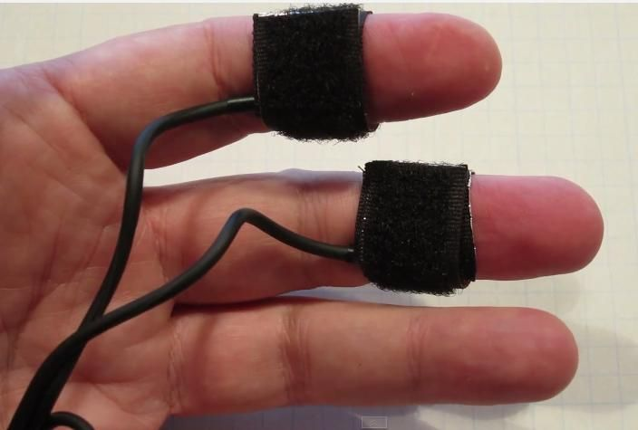
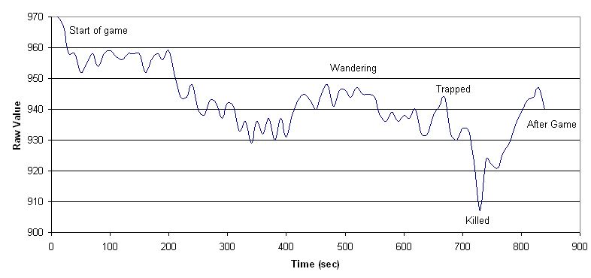
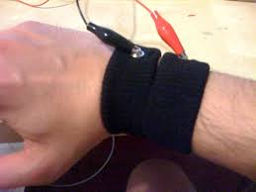
Galvanic Skin Response (GSR)
Or Electrodermal Response (EDR), Skin Conductance Response (SCR)
Notes:
Explain it into more detail later slide

Slide 8
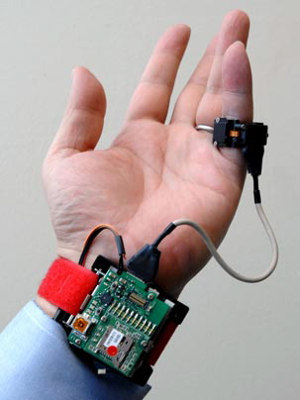
Other psysiological responses
Blood oxygen level
Skin temperature / heat flux
Blood pressure
Motion (measured using accelerometer)
...
Multiple can generally be measured simultaneously

Slide 9
Galvanic Skin Response (GSR)
Measuring the electrical skin conductance
Small voltage applied to electrodes, flowing current measured
Influenced by sweat glands
Delay between stimulus and response between 0.8 and 4 seconds
Notes:
GSR is measuring the electrical skin conductance,
Unit of measurement is micro siemens
More sweat -> higher conductance, sweating caused by primitive ‘fight or flight’ response, preparing for exertion to deal with threat
Delayed response

Slide 10
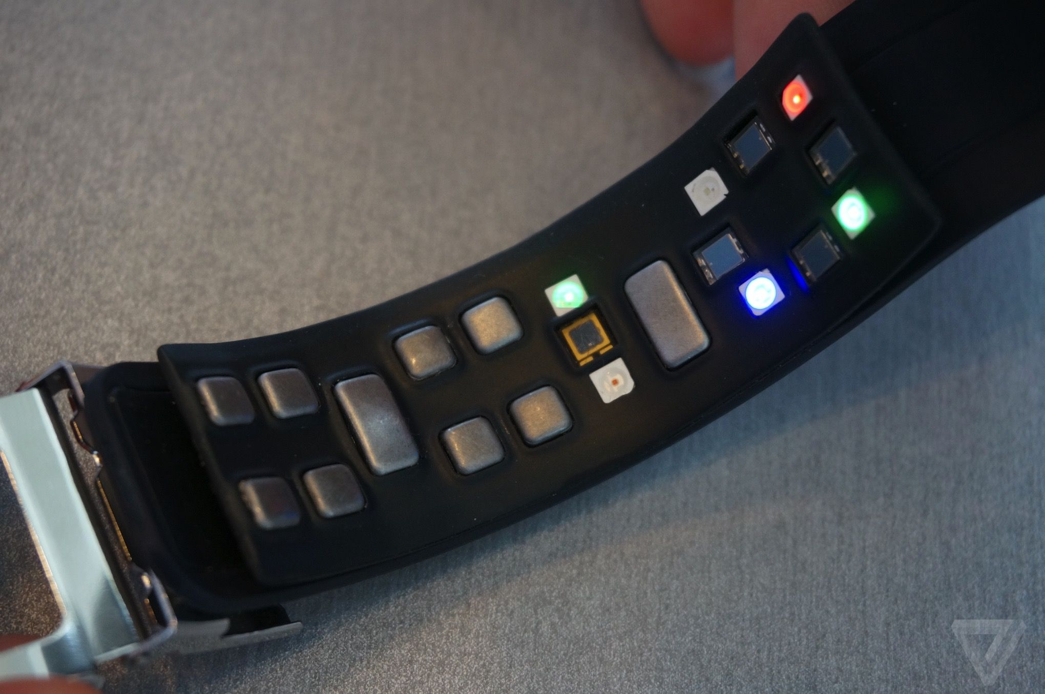
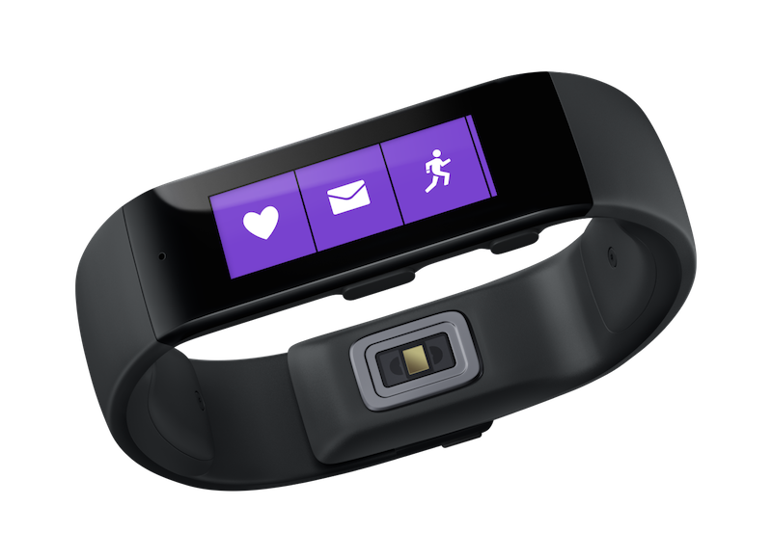
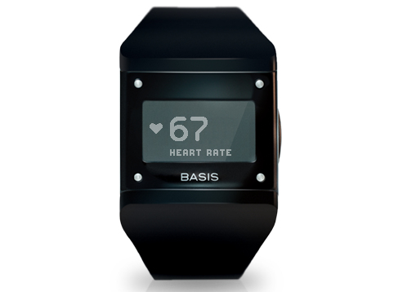
New smartwatches feature biometric sensors
APIs are generally lacking, data is locked in proprietary apps
Samsung Simband
Microsoft Band
BASIS Watch

Slide 11
Why measure cognitive load?
“You should take a break”
Automatic difficulty adjustment in applications (such as games)
People on the autism spectrum do display physiological response
Classroom applications, are students following/getting it?

Slide 12
Goal
Determining cognitive load from GSR data
Method
Measure GSR data using tasks with varying difficulty
Classify task difficulty from features of the GSR data

Slide 13
Experiment
Arithmetic tasks with varying difficulty
Addition of four numbers, presented one by one
4 difficulty levels
8 tasks per subject, in random order
Difficulty | Example Task
1 | 0 + 1 + 1 + 1
2 | 3 + 5 + 7 + 2
3 | 31 + 40 + 67 + 24
4 | 163 + 721 + 573 + 594
Notes:
Harder because
add larger numbers
remember a larger number.

Slide 14
***

Slide 15
48

Slide 16
71

Slide 17
34

Slide 18
50

Slide 19
203
196
199

Slide 20
**

Slide 21
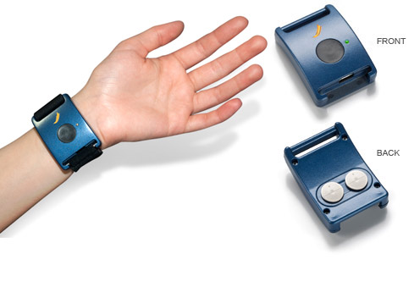
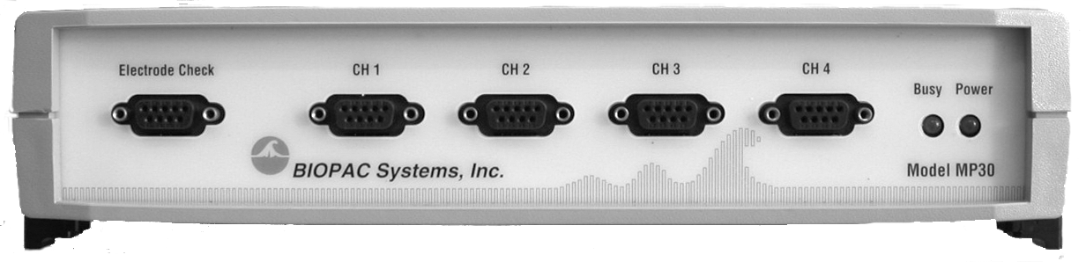
Apparatus
Affectiva Q Sensor (dry electrodes on wrist)
BIOPAC MP30
(wet finger electrodes)

Slide 22
Q Sensor Data
Data proved unusable, proper connection to skin not present in many subjects
Needs some sweat present from the get-go
Lesson learned:
Have subjects wear them longer before the first task starts
Ask subjects to do some mild exercise beforehand

Slide 23
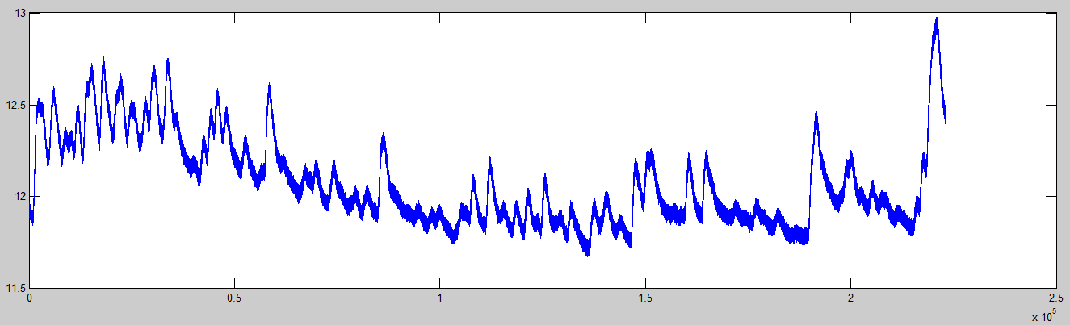
Raw data

Slide 24
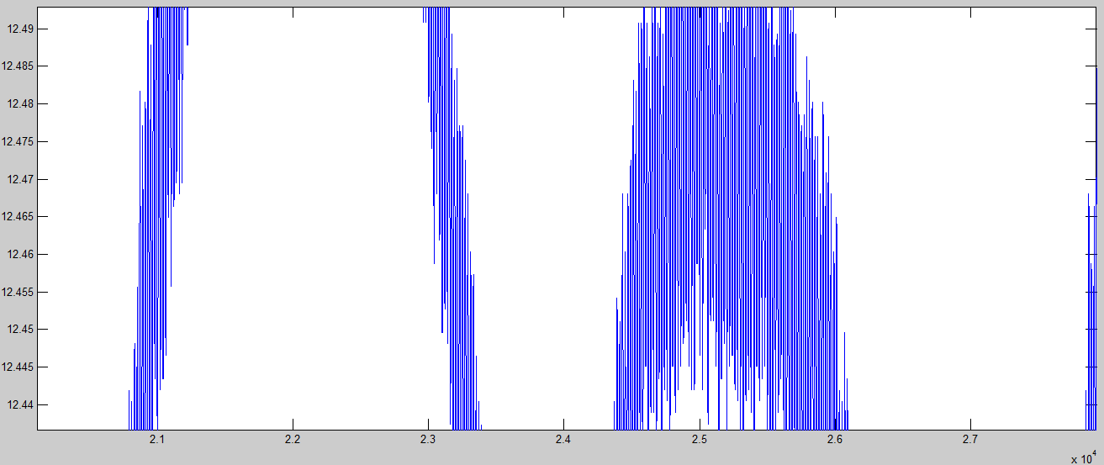
Raw data
DC current noise (50Hz) in signal

Slide 25
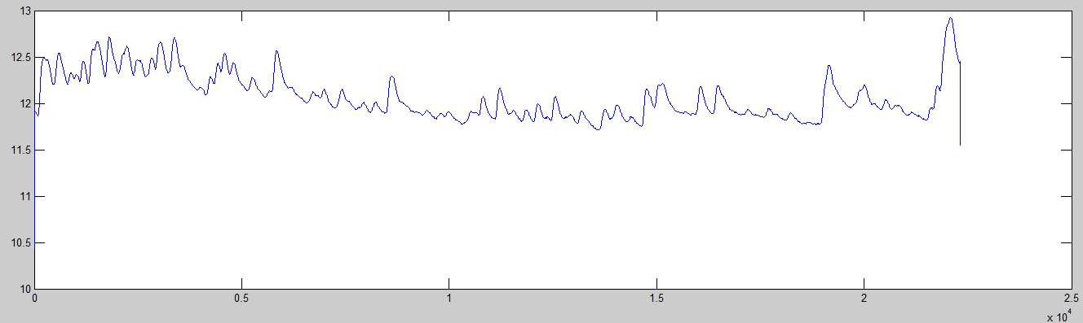
Preprocessing
Smoothing filter (removing DC current)
(Savitzky-Golay filtering)
Notes:
Low Pass Filter didn´t cut it

Slide 26
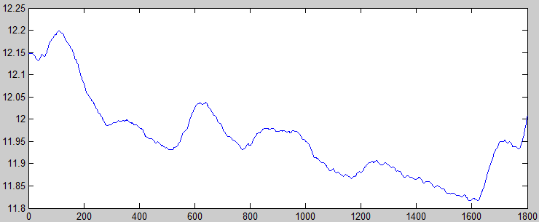
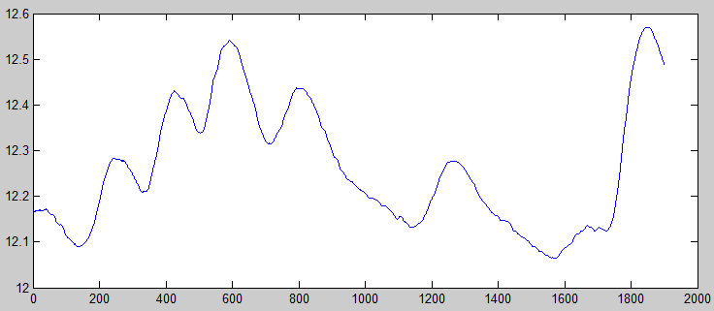
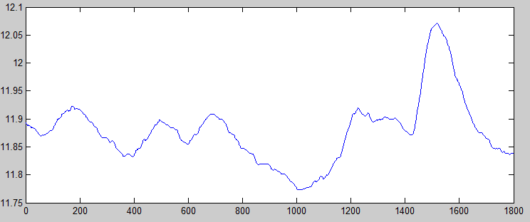
Preprocessing
Cutting the tasks out of the data
...

Slide 27
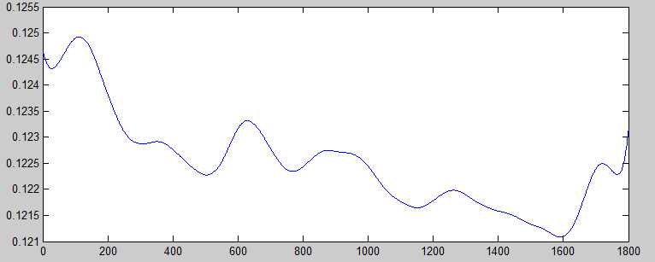
Final preprocessing
Normalizing (dividing by subject average GSR over all tasks)
Smoothing out small DC current spikes (Savitzky-Golay filtering)

Slide 28
Transformation
Extract time domain features
Export to an easily parsable format (CSV)
'luc' 'diff1' [220.5357] [0.1225] ...
(Name, Difficulty, accumulative GSR, Average GSR)

Slide 29
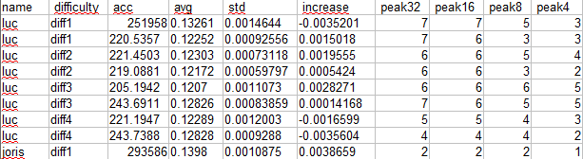

Building a classifier
CSV data fed to Weka Data Mining Software
Allows for easily trying multiple classifier training algorithms
Also great for visualization

Slide 30
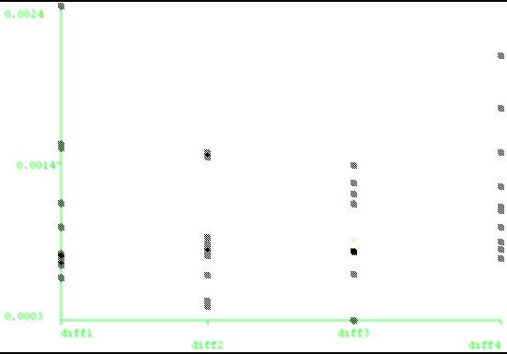
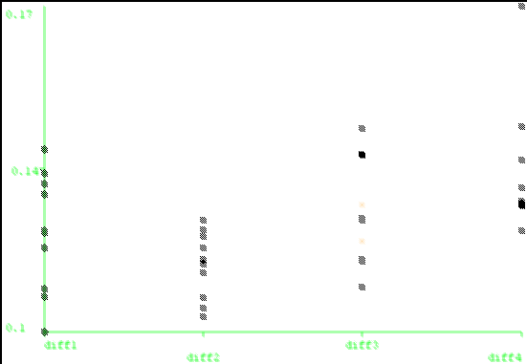
Visualization
Standard Deviation vs Task Difficulty
Average GSR vs Task Difficulty

Slide 31
Preliminary results
10 Folds cross-validation was used
Classifier | Correctly Classified Instances %
SimpleCart (Minimal Cost Decision Tree) | 33.33%
J48Graft (Decision tree) | 43.75%
BayesNet (Bayesian probability estimation) | 25%
Naïve Bayes | 33.33%
LWL (Locally weighted learning) | 41.67%
Multilayer Perceptron (20 hidden layers) | 29.17%
SMO (Support Vector Machine class algorithm) | 6.25%
JRIP (Rule based learner) | 18.75%
Simple classifiers seem to work best. Expected from small dataset size.
Notes:
Note that 25% is expected from chance
Not great.

Slide 32
Preliminary results
10 Folds cross-validation was used
Classifier | Correct % 4 classes | Correct % 2 classes
SimpleCart (Minimal Cost Decision Tree) | 33.33% | 72.92%
J48Graft (Decision tree) | 43.75% | 77.08%
BayesNet (Bayesian probability estimation) | 25% | 75%
Naïve Bayes | 33.33% | 60.42%
LWL (Locally weighted learning) | 41.67% | 75%
Multilayer Perceptron (20 hidden layers) | 29.17% | 62.50%
SMO (Support Vector Machine class algorithm) | 6.25% | 58.33%
JRIP (Rule based learner) | 18.75% | 79.12%
Classifying between two classes yields a better classification accuracy
Notes:
Classifying between task 1,2 and task 3,4 combined
50% expected from chance.
Still not great / good enough

Slide 33
Improving the classification
Classification accuracy is not great however, possible reasons
Small dataset (6 participants * 8 tasks = 48 entries)
Not the right features extracted from data
It is simply not classifiable better from GSR data

Slide 34
Summary
Using biometrics to determine cognitive load outside of the lab is exciting
I measured GSR during tasks of varying difficulty
Classifying task difficulty from this data is the goal
Next up is seeing whether I can improve this classification

